Slide 1
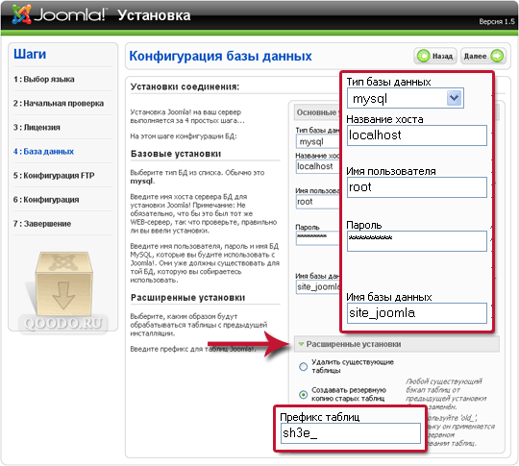
Vote

Slide 2
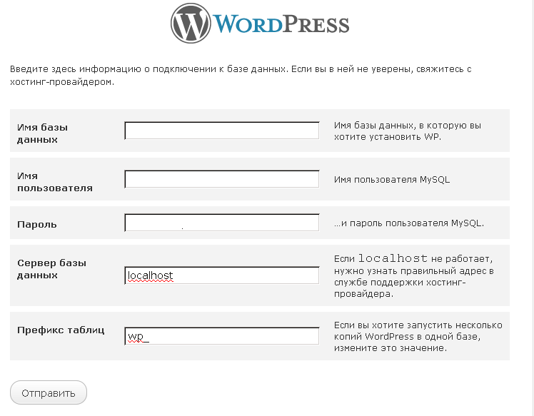
Vote

Slide 3
Database honeypot by design
@GiftsUngiven
@cyberpunkych

Slide 4

Pre-history

Slide 5
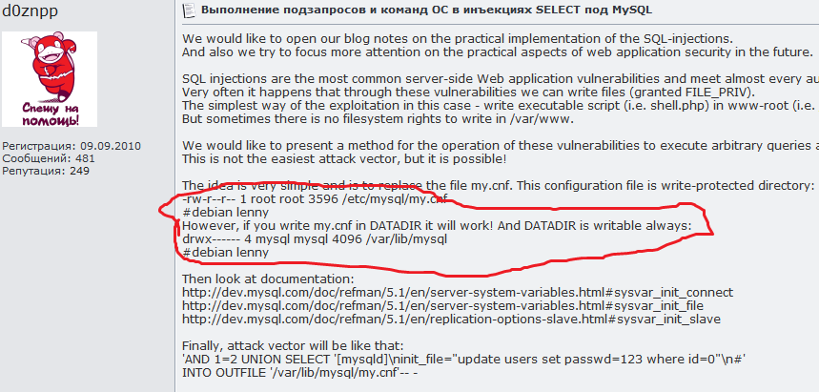
☹

Slide 6
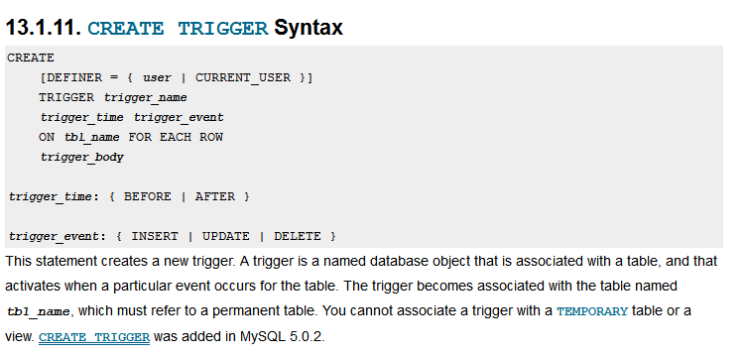
☹

Slide 7


Slide 8
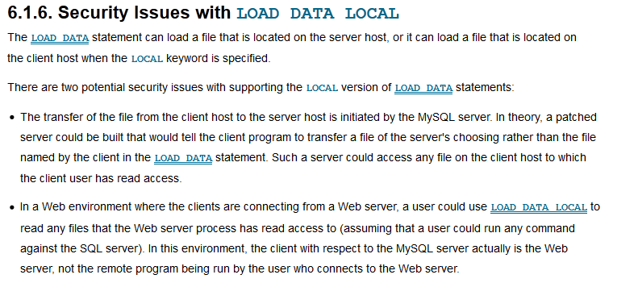
bla bla bla

Slide 9

Data analysis
Бро, не забудь надеть очки,
дальше хэкерская правда

Slide 10
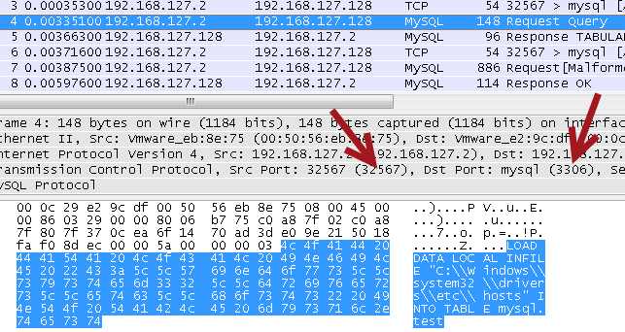
Data analysis #1 client request
LOAD DATA LOCAL INFILE "C:\\Windows\\system32\\drivers\\etc\\hosts" INTO TABLE mysql.test

Slide 11
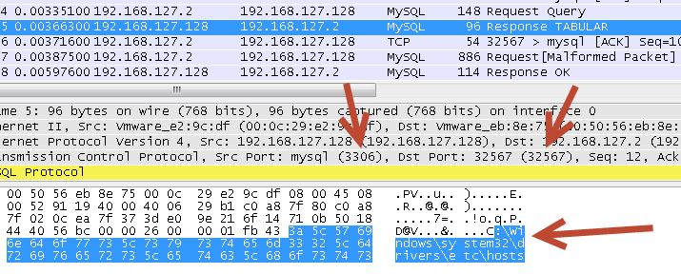
Data analysis #2 server response

Slide 12
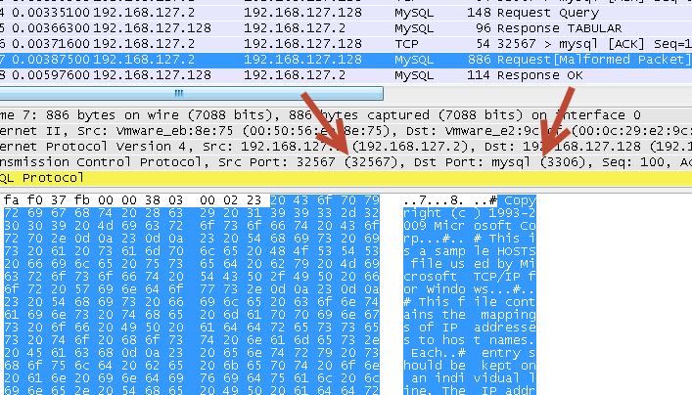
Data analysis #3 client answer

Slide 13
Data analysis #?
What if we skip client request and just send server response to get a file for any request?

Slide 14

Data analysis #?

Slide 15
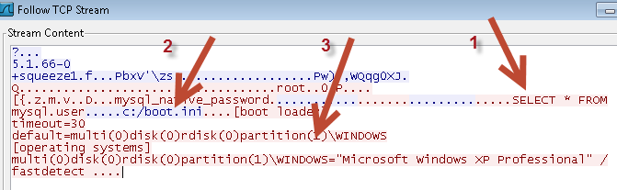
Data analysis #!
1 – client send ‘select’ query request
2 – server send response ‘I want a file’
3 – client send file content

Slide 16


Profit!
a little bit of script language to automate process
A lot of fun

Slide 17
Remember me? Now you know what to do!

Slide 18


Honeypot?
Want to hack my mysql? Okay… I will exchange your requests for your files.
Please, run ‘msfconsole’ under root.

Slide 19


Whhyyyyyy?

Slide 20

Good guy Ares
We: MiTM?
Ares: No problems!
http://intercepter.nerf.ru/

Slide 21
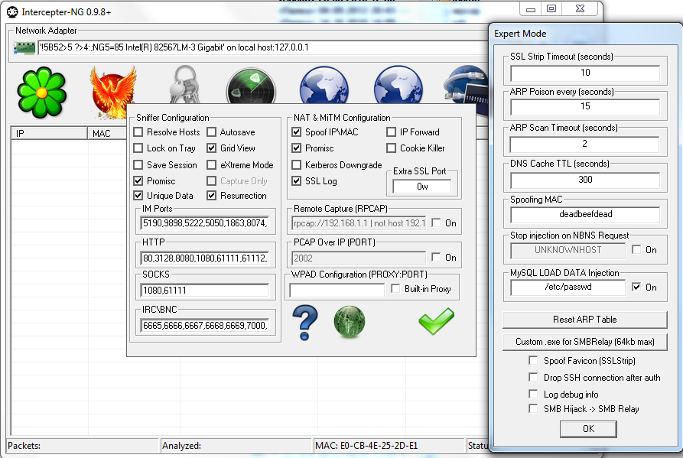
Good guy Ares

Slide 22
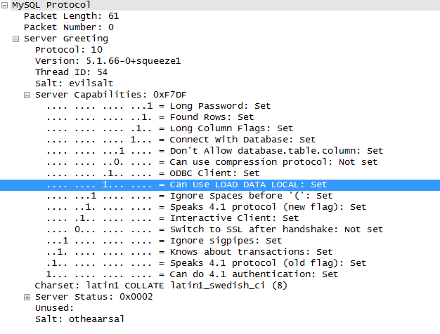
Is it vulnerable?

Slide 23
Tnhx.
questions?

